Slide 1
FRIEND BLEND
Team Name: FB
Team Mentor: Prathyakshun Rajashankar
Team Members:
Ritvik Agrawal (Team Leader)
Kirandevraj
Vivek Chwandela
Github Repo Link: https://github.com/Kirandevraj/FriendBlend

Slide 2
Problem Statement
Friend-Blend is an application that merges two portraits of different people to create a single, multi-person photo.

Slide 3
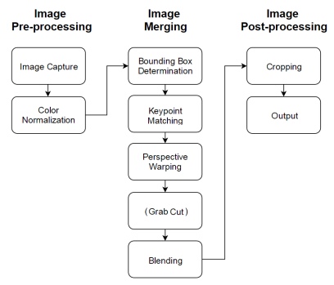
Pipeline of the project
Color Correction
Face and body detection
Keypoint Matching
Homography
Blending
Alpha Blending
Grabcut
Limitations & Analysis
Presentation

Slide 4
Color Correction
Convert RGB to LAB color space
This allows to modify the lightness channel of the image without interfering with the color.
Perform CLAHE and convert back to RGB space.
This makes sure both the images have similar background lighting conditions to avoid artefacts during blending.

Slide 5
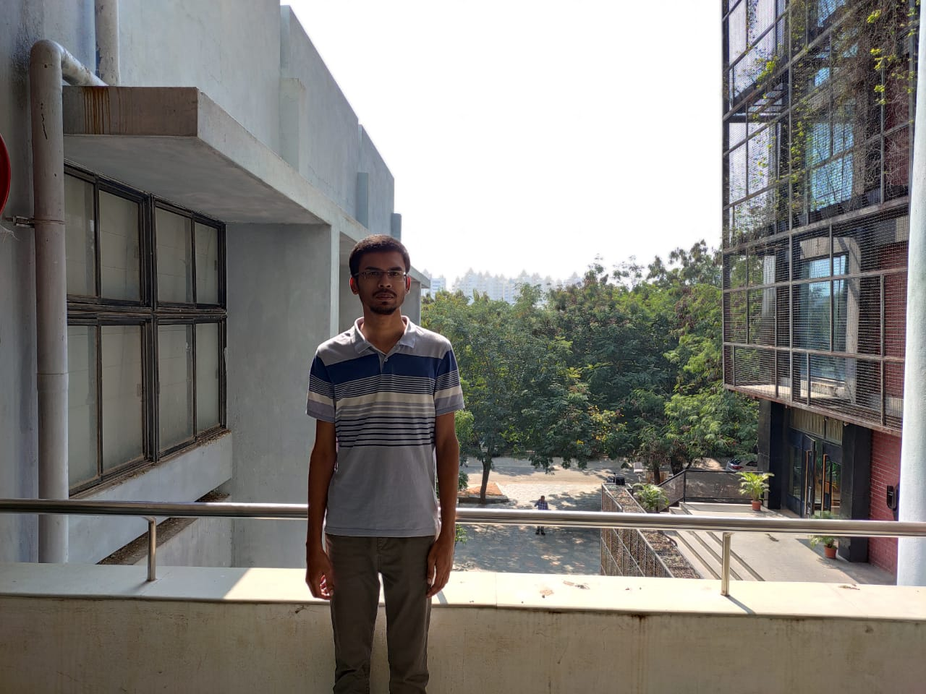
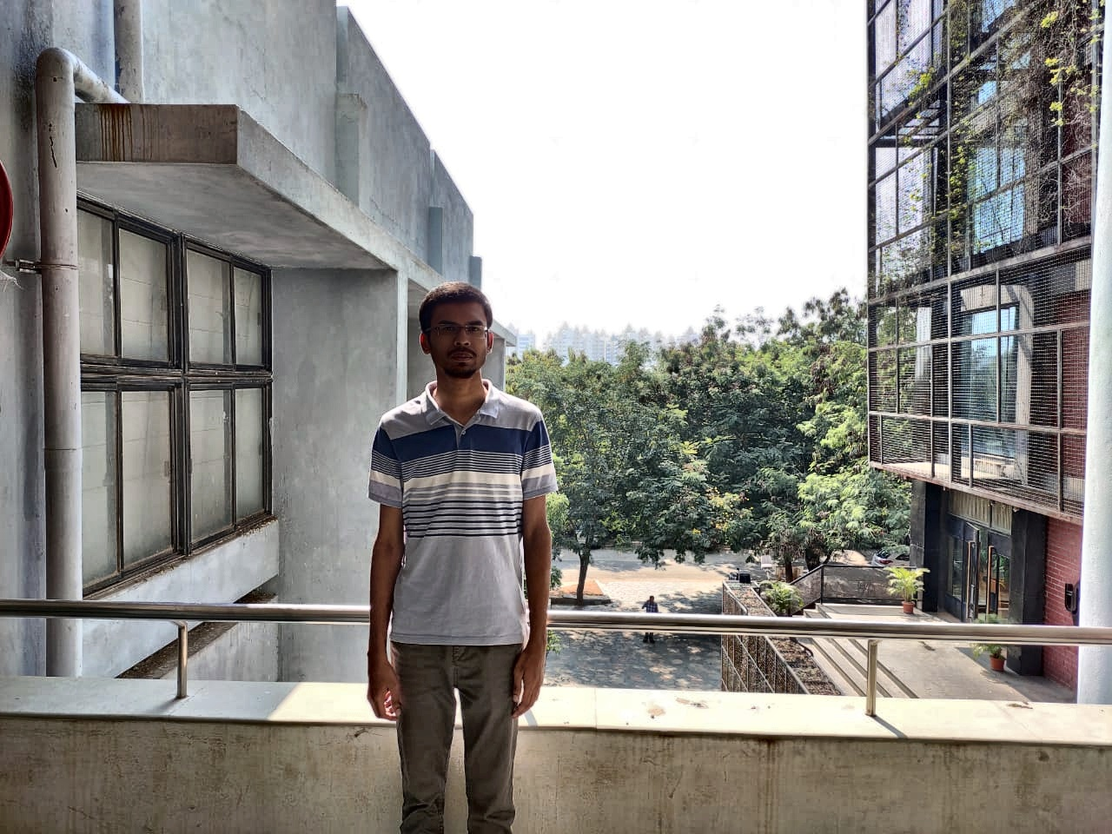
Original Image
Color Corrected Image

Slide 6
Face and body detection
Haar cascaded classifier for frontal faces is used for extracting a bounding box for the face of each person by taking fixed ratios of height and width of the face..
The original paper uses a static scale for detecting faces in the input image which doesn’t work with many images in the dataset that we collected.
To generalize this, we iterate through different scales until a face is found, making it robust to many different scales.

Slide 7
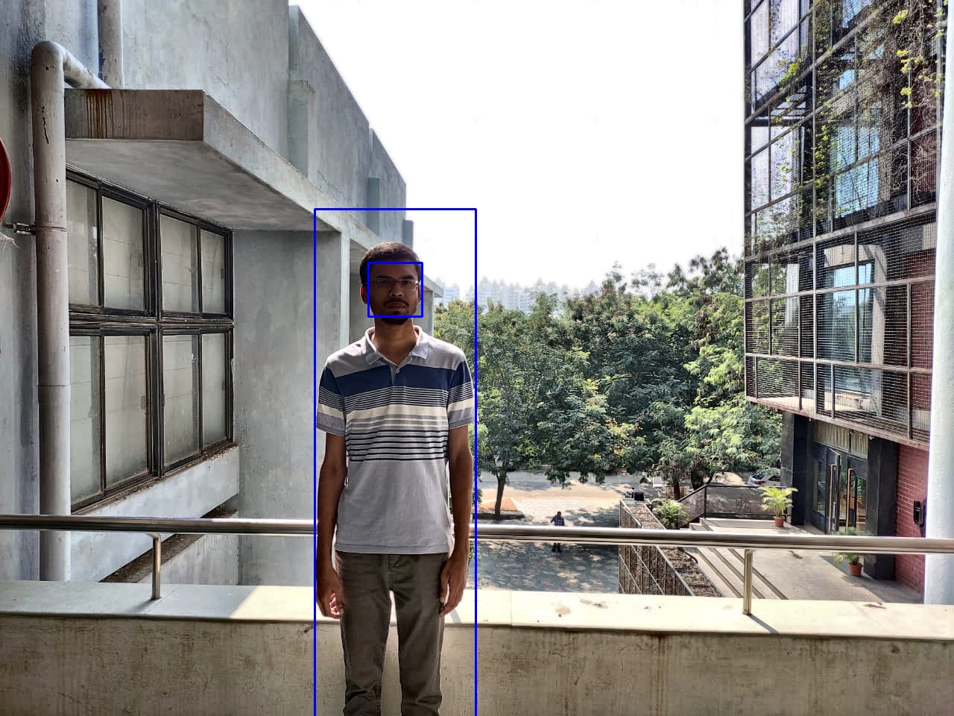
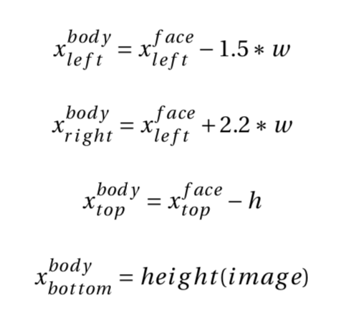
Results
Formula for bounding box

Slide 8
Keypoint detection & Matching
ORB keypoint detector is used to determine mapping between the 2 input images with Hamming distance being the preferred distance measure.
Total of 10000 key points are extracted from the image
Only key points outside the bounding boxes of each subject in the images.

Slide 9
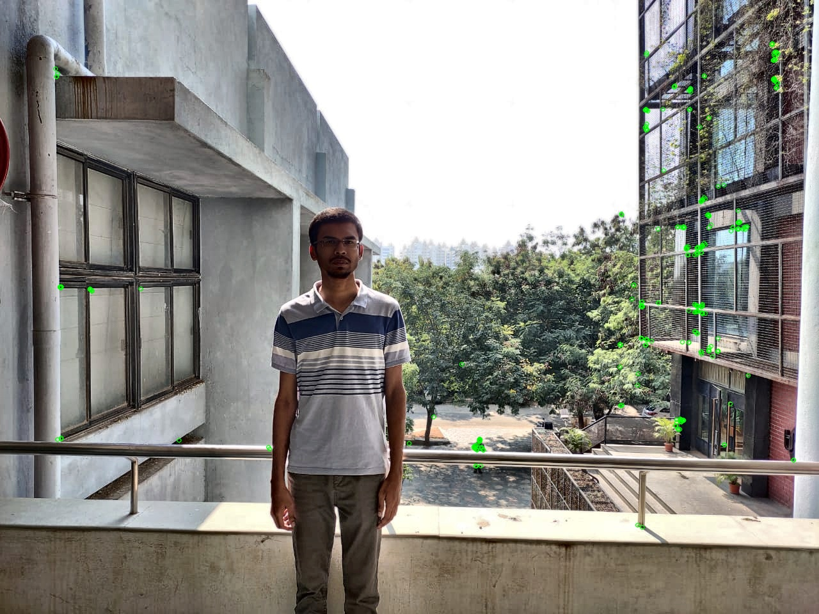
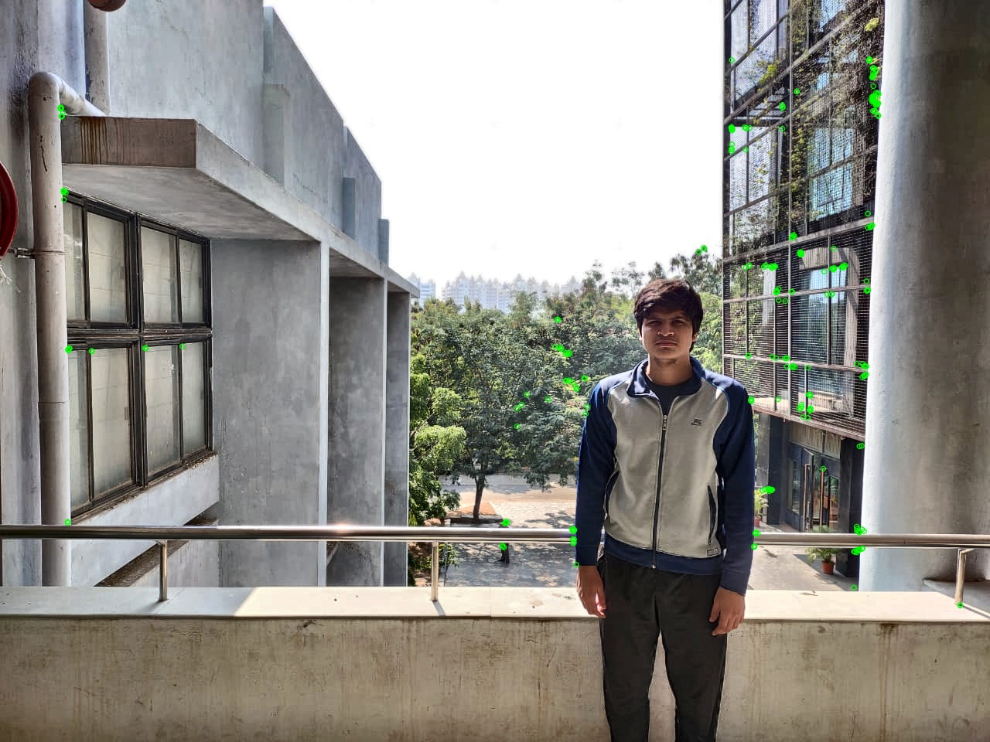
Keypoint Detection
Image 1
Image 2

Slide 10
Valid Key Points
Image 1
Image 2

Slide 11
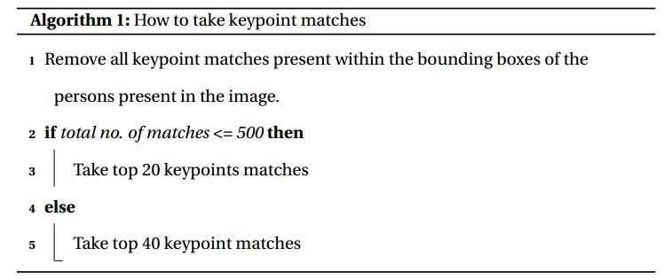
Keypoint Matching
BFMatcher is used for keypoint matching using Hamming distance as a metric.
Algorithm:

Slide 12
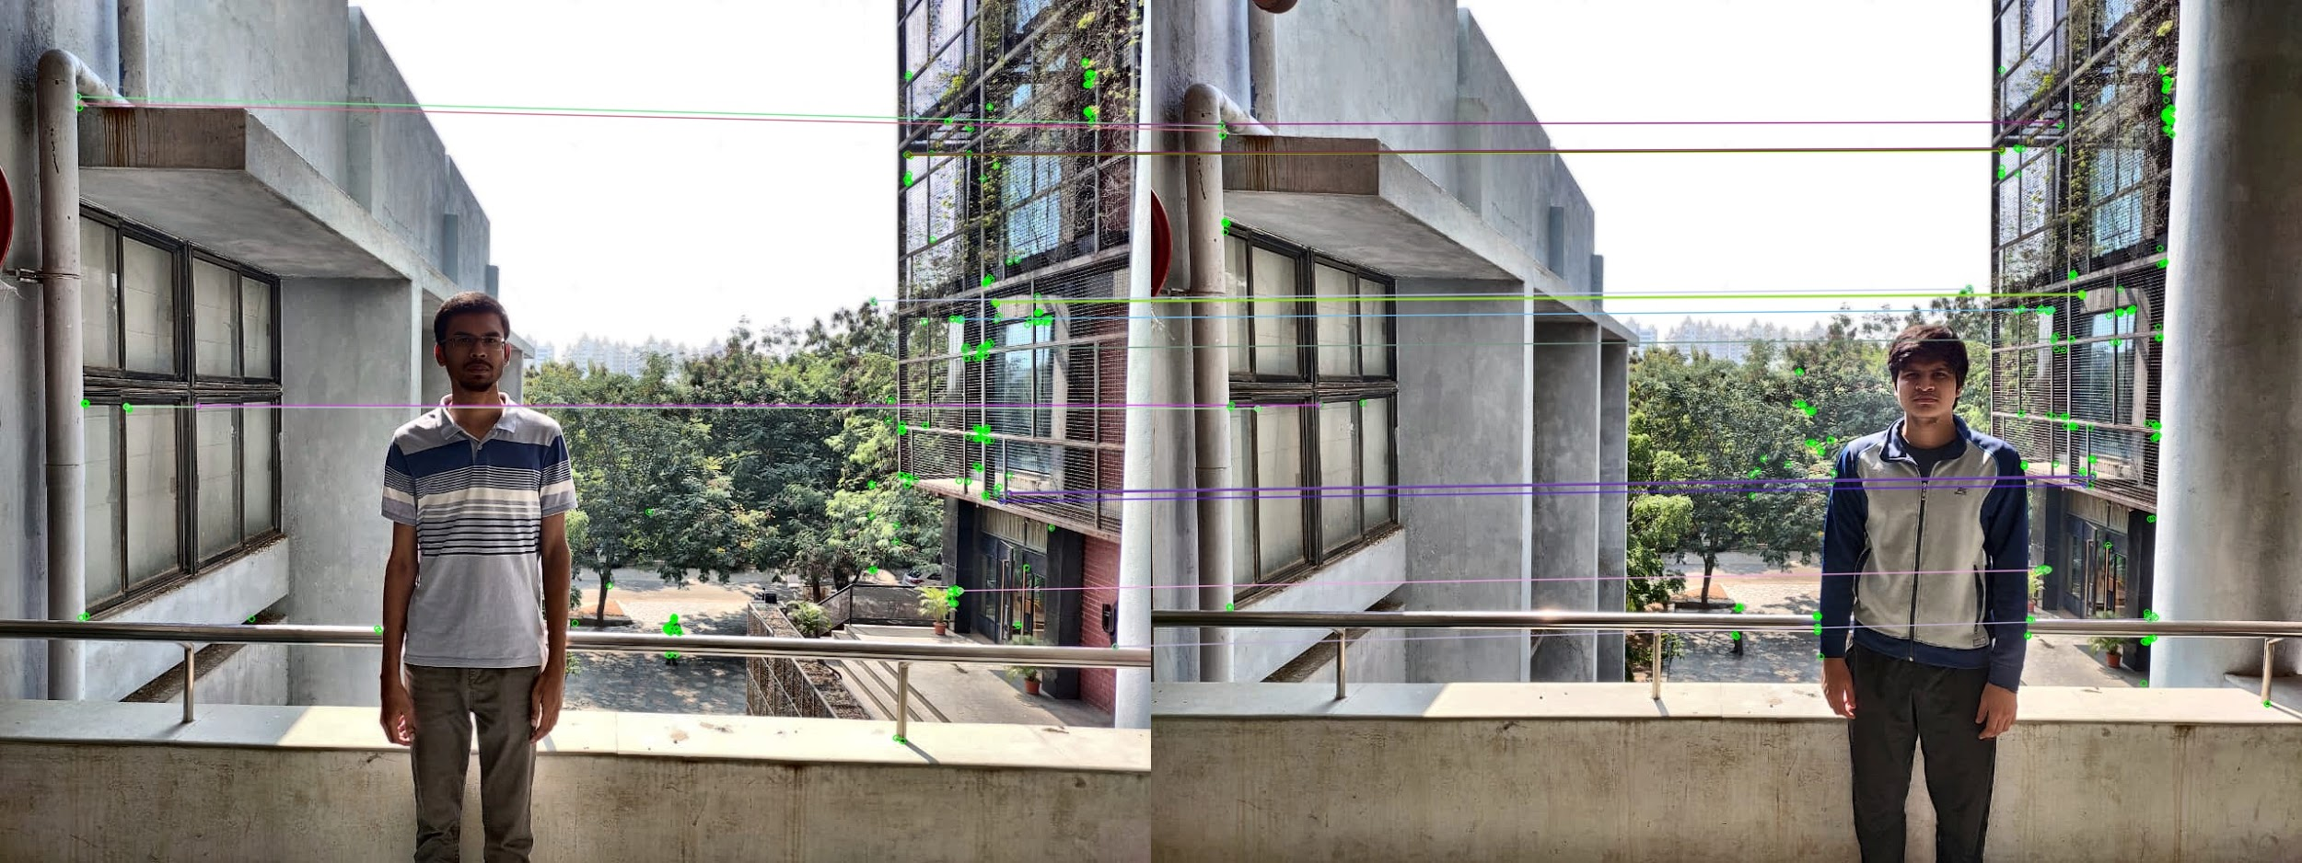
Keypoint Matching
BFMatcher results for keypoint matching

Slide 13
Homography
Using the top k keypoint matches selected by the previous step, we create a homography transform.
RANSAC algorithm is used to single out the best transform.
Next, we warp one image using the homography transform to match with the other image which enables us to align two images without additional artefacts when merged together.
The determination of the foreground and background images is important when image subjects overlap but does not need to be done if the body bounding boxes are distinct.

Slide 14
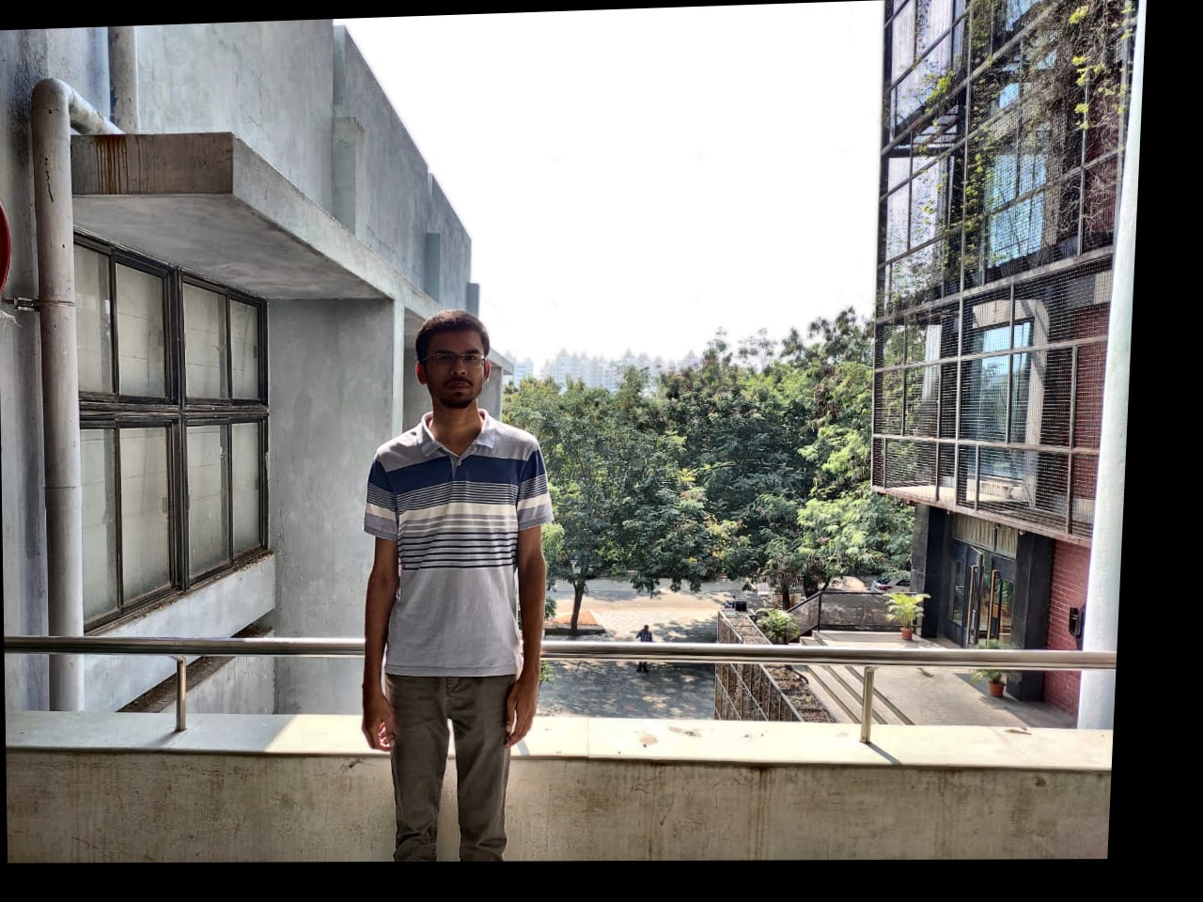
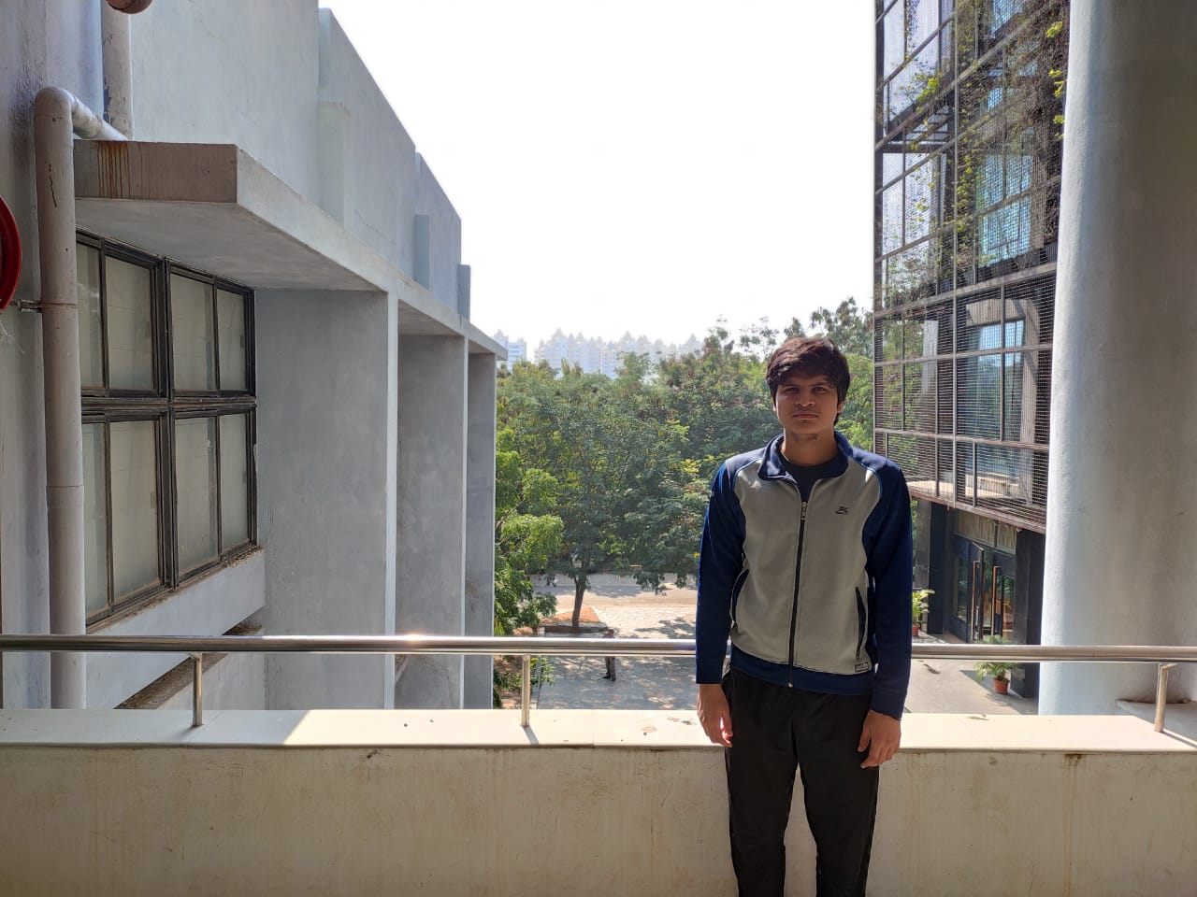
Homography Results

Slide 15
Blending
Blending is the final step to merge two images.
We follow two approaches for blending the images depending on the relative locations of the persons in images.
If both the locations are at least 200 pixels apart from each other then we do alpha blending else grabcut is done.
Distance between body bounding box <=100
Yes
No
Grabcut
Alpha Blending

Slide 16
distance

Slide 17
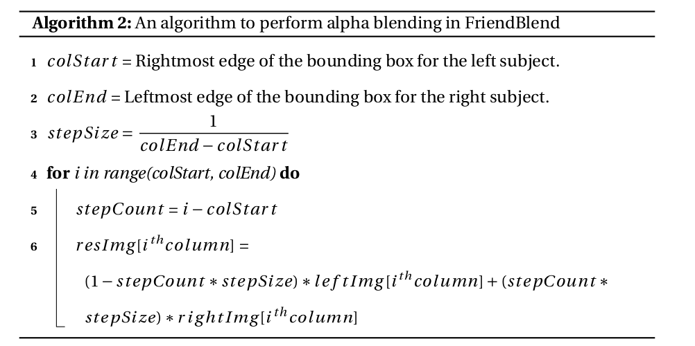
Alpha blending Algorithm

Slide 18
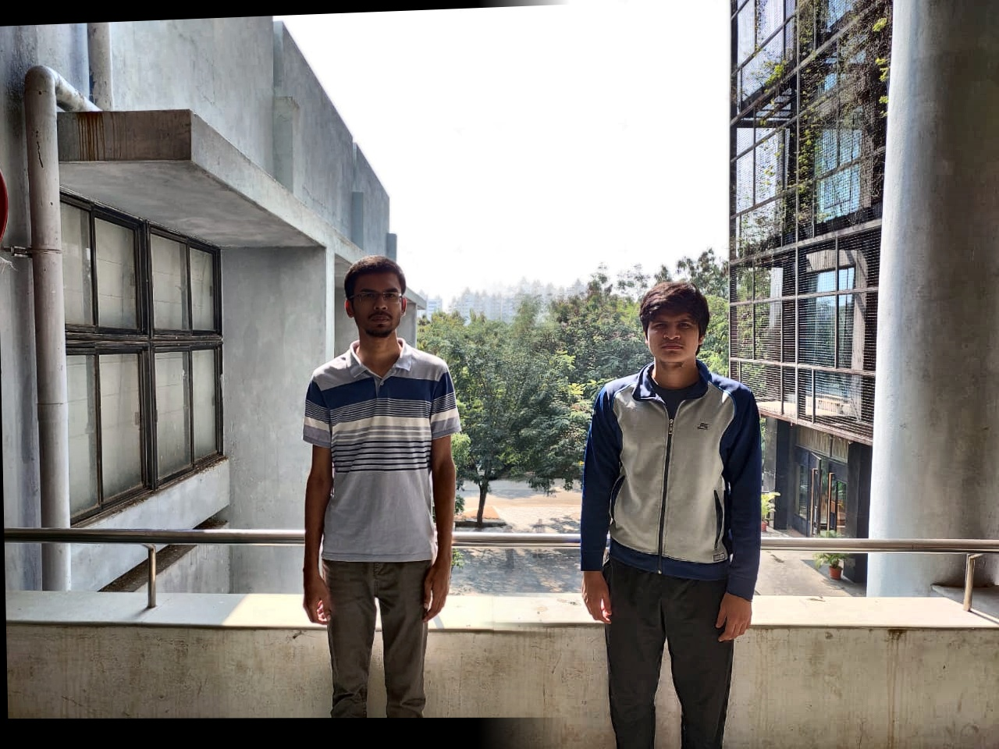
Alpha Blending Results
Input 1
+
=
Output from the algorithm after alpha blending
Input 2

Slide 19
Grabcut
Grabcut is a technique used to segment out the foreground from background pixels.
This techniques requires labelling a few for sure foreground pixels and probable foreground pixels.
Internally it tries to model the pixels into two classes, foreground and background using Gaussian Mixture Models.
This outputs an image containing only the predicted foreground pixels, which acts like a mask.

Slide 20
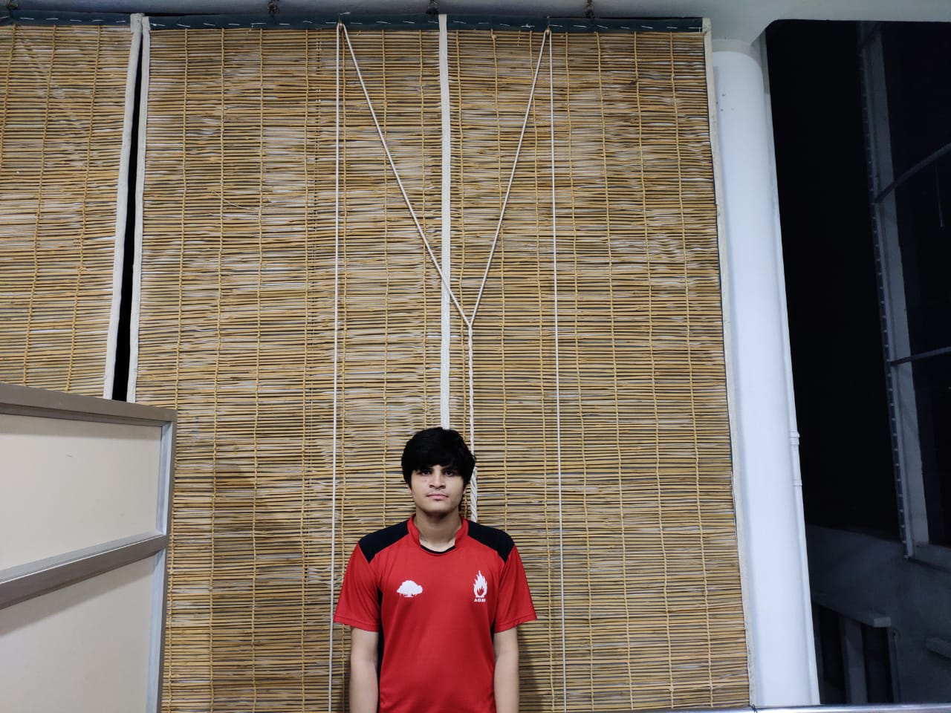
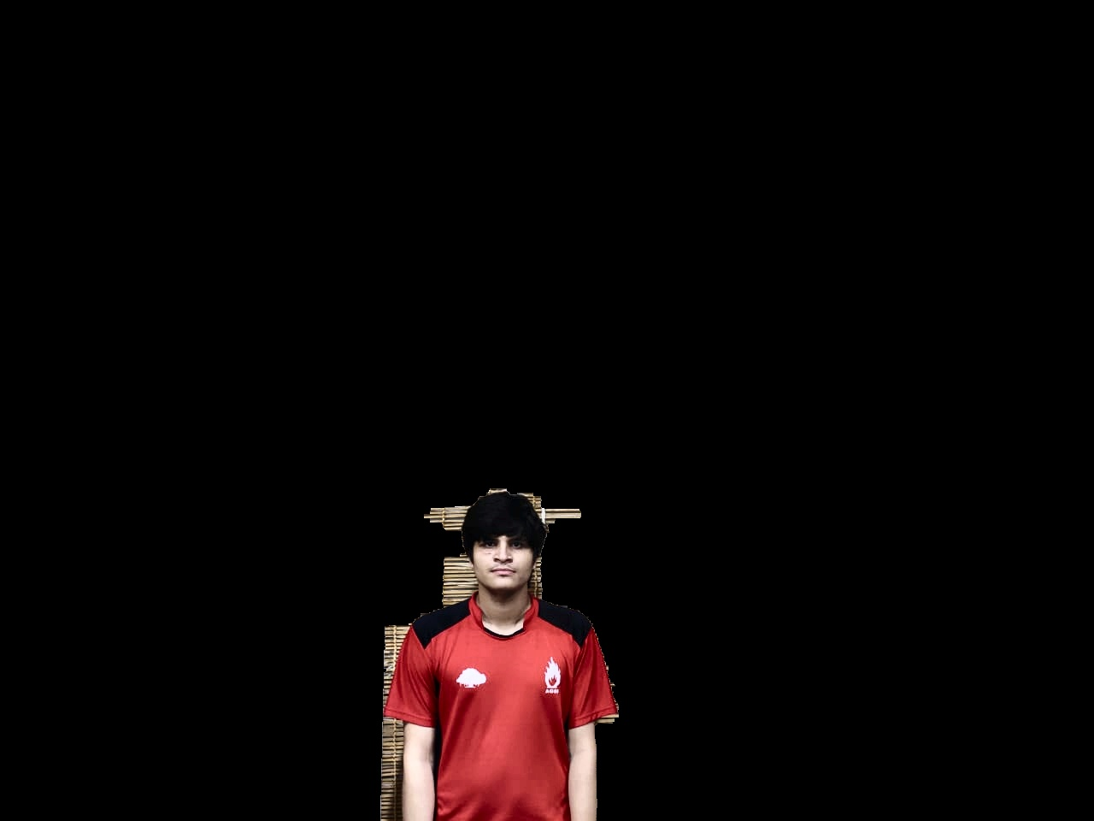
Grabcut - Binary Mask
Input to grabcut with sure foreground and probable foreground
Binary mask output from grabcut

Slide 21
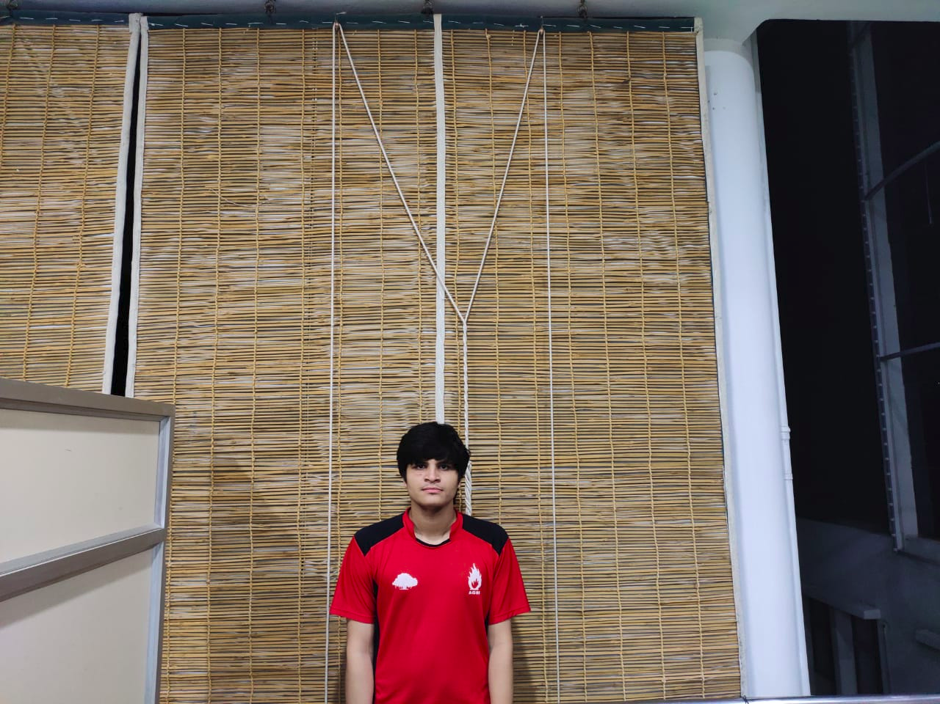
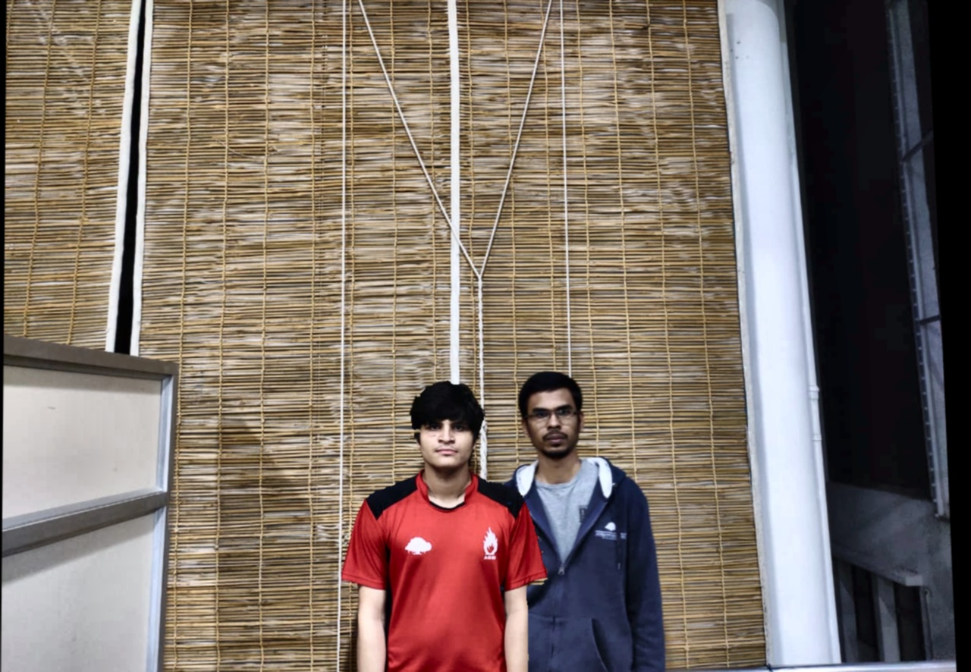
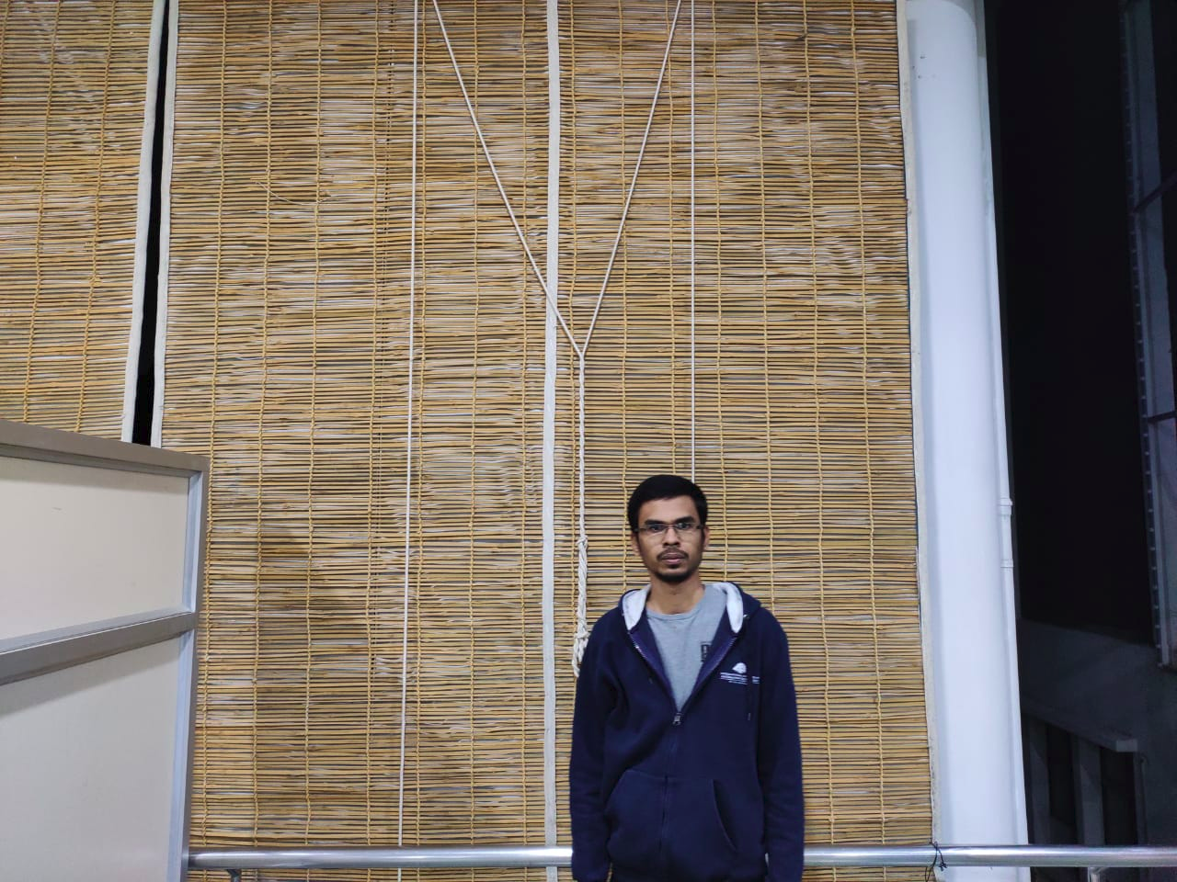
Grabcut Result
Input 1
+
=
Output from the algorithm after grab-cut blending
Input 2

Slide 22
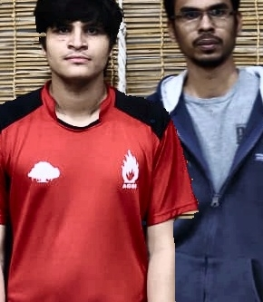
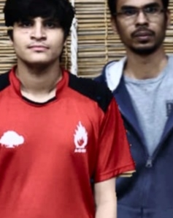
Edge-Artifacts
After doing Gaussian Blurring
Where everything fails, use Gaussian filter
😜

Slide 23
Limitations
Homography being a very crucial step of the process, this algorithm inherently includes all the limitations of homography.
One of the major challenges was to make grabcut give better results. Still a challenge!

Slide 24
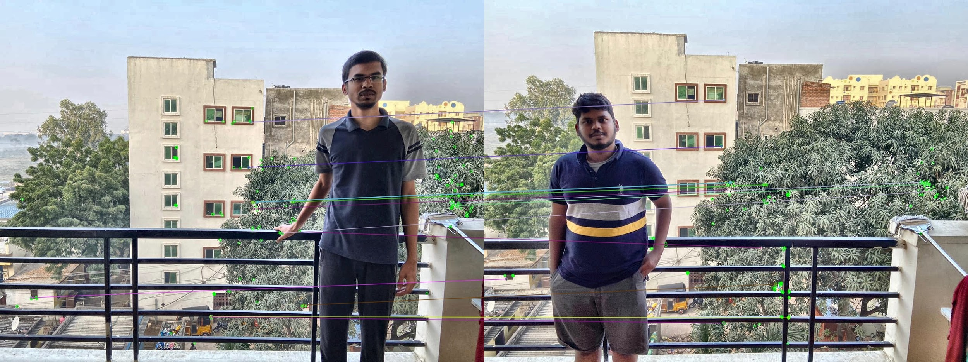
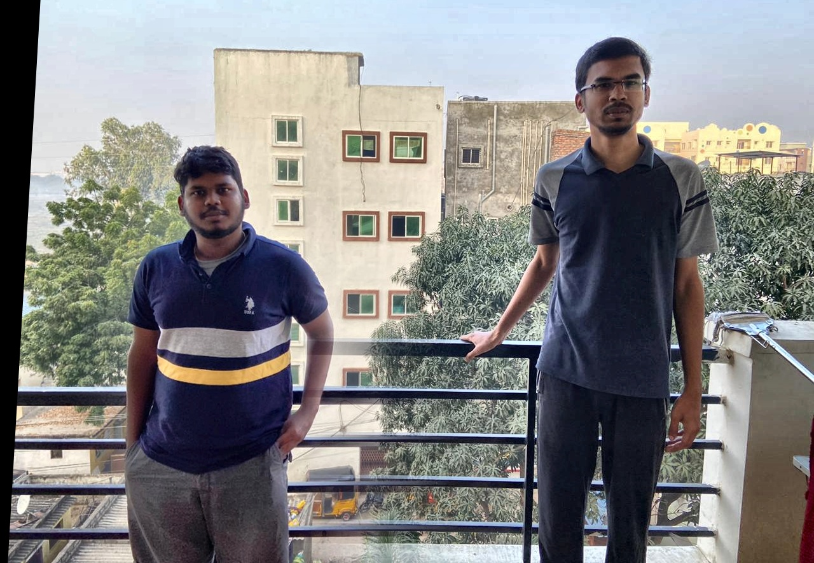
Homography
Improper Alignment after Alpha Blending due to poor homography.

Slide 25
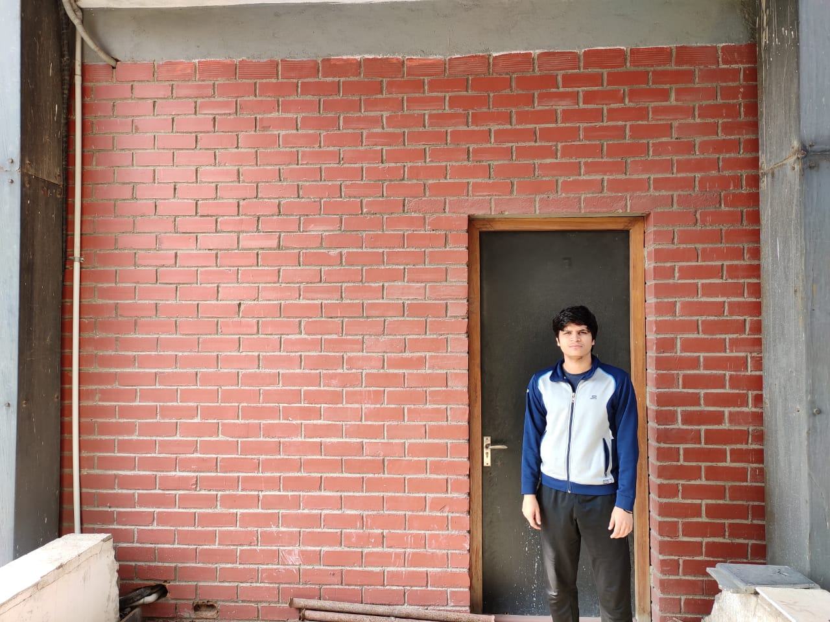
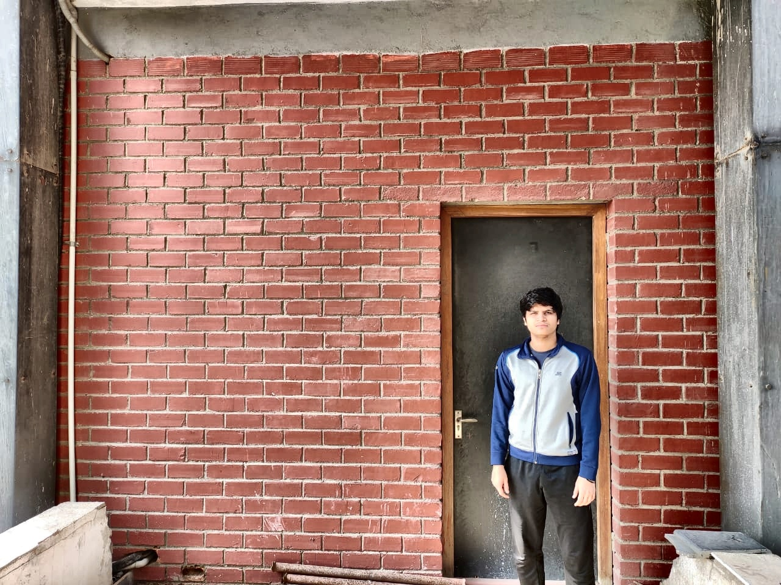
Color Normalization Error
Original Image
Result

Slide 26
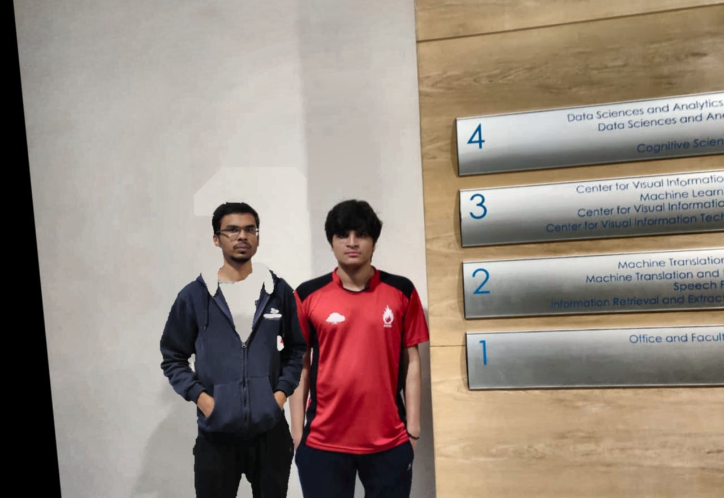
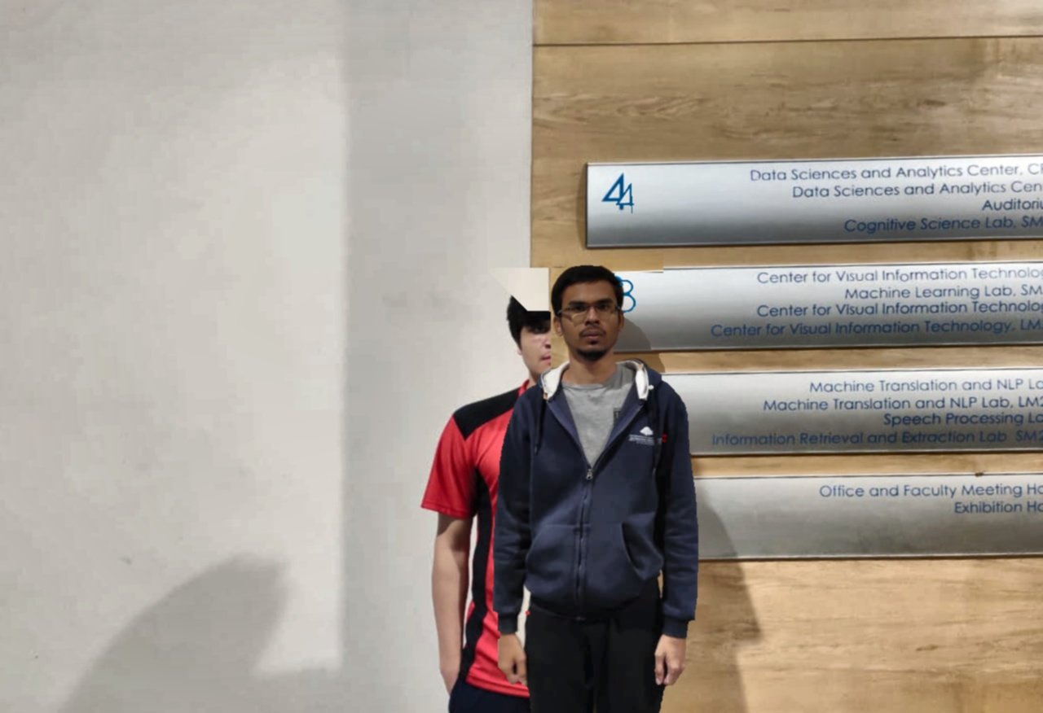
Grab-Cut

Slide 27
Contributions
Color Correction - Vivek
Face and body detection - Ritvik (50%), Kirandevraj (50%)
Keypoint Matching - Ritvik (40%), Kirandevraj (30%), Vivek (30%)
Homography - Kirandevraj (60%), Vivek (40%)
Blending - Vivek (40%), Kirandevraj (30%), Ritvik (30%)
Alpha Blending
Grabcut
Limitations & Analysis - Kirandevraj (70%), Ritvik (30%)
Project Presentation - Ritvik (50%), Vivek (50%)

Slide 28
THANK YOU !
Suggestions ?
Questions ?

